Slide 1



Web Based Diabetic Retinopathy Detection using Deep Learning
Under the Supervision of
Dr. Konstantinos Tsakalidis
Paul Spirakis
Presented by
Mukundakrishnan Suresh Kumar
201604427

Slide 2

INTRODUCTION
Problem Statement:
Identification of Diabetic Retinopathic condition using Retinal Fundus images
To develop and deploy a ML model
Results in one stop solution for identification, classification and deployment of DR model using Deep Learning Techniques.

Slide 3
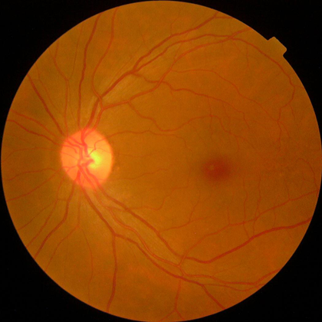
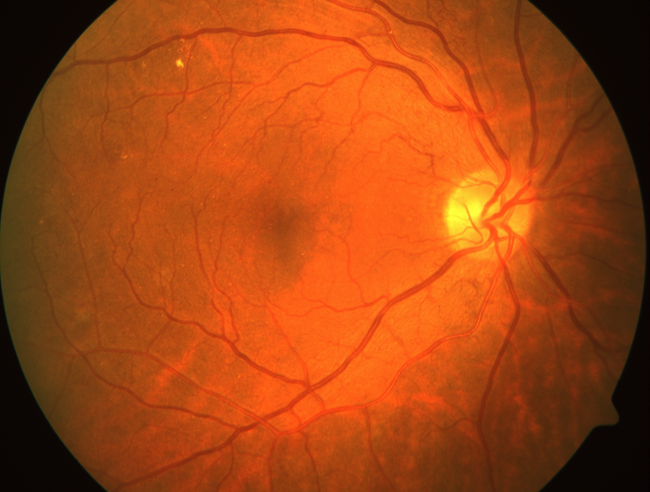
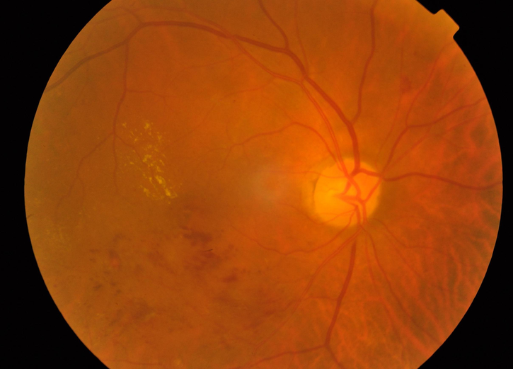
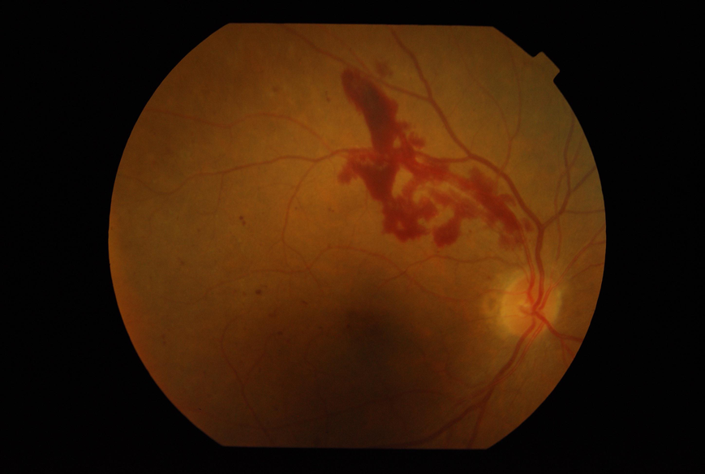
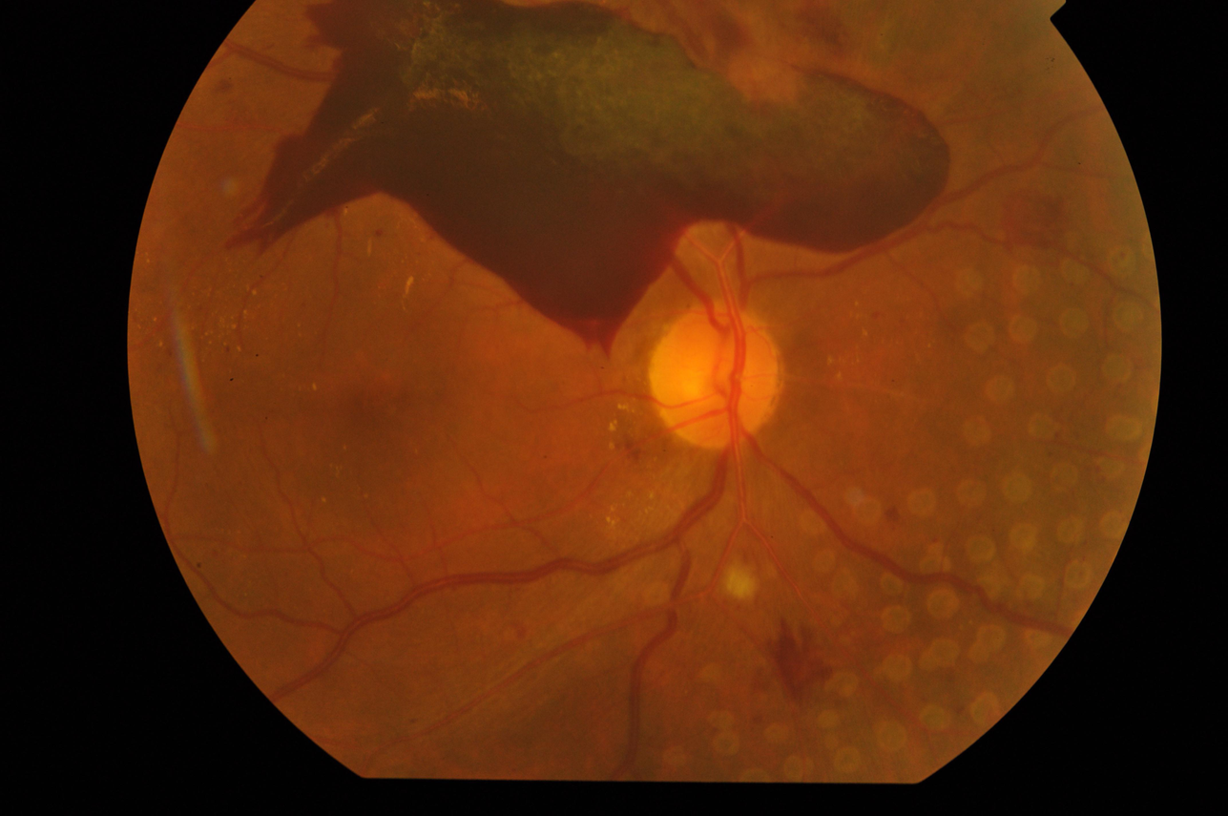

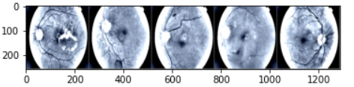
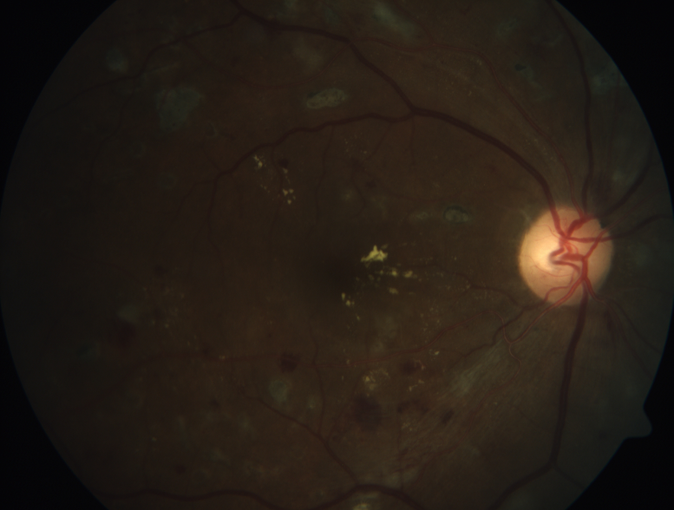
DATASET
APTOS Dataset:
No DR
Mild DR
Moderate DR
Severe DR
Proliferate DR
Data Preprocessing:
Image Resizing and cropping
Gray-Scaling
Balancing
Dropping noisy images

Slide 4

DEEP LEARNING MODELS
Vision Transformer
ResNet
DenseNet
Implementation:
Mission
High Performance Computer
Personal Computer / Cloud

Slide 5
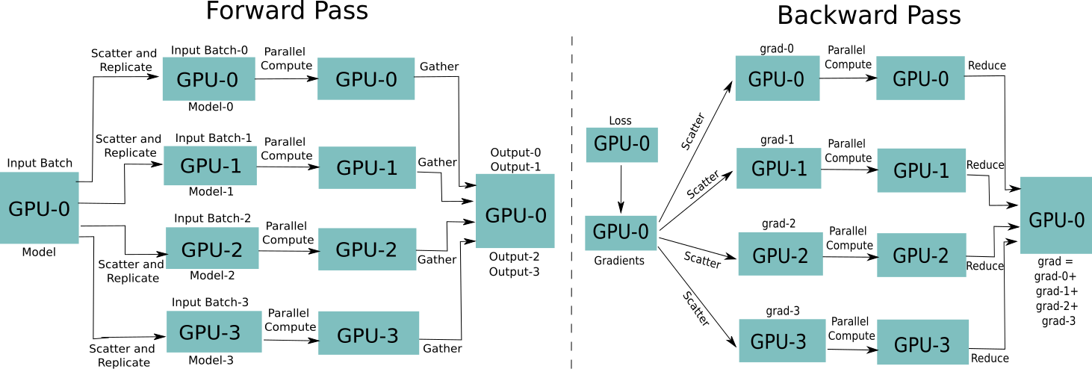
HPC ARCHITECTURE
Supporting mechanisms used: CUDA, NCCL, DDP

Slide 6
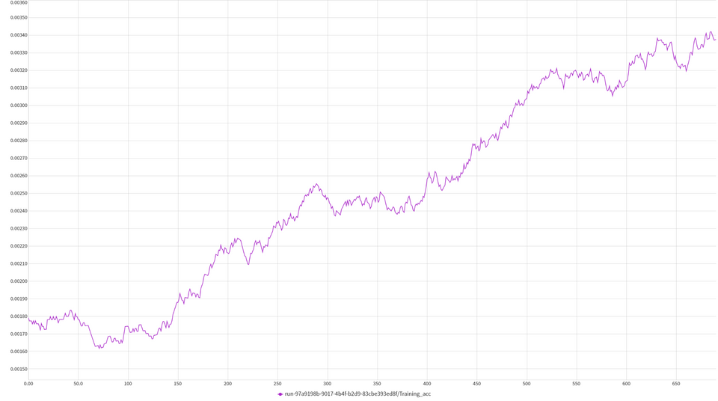
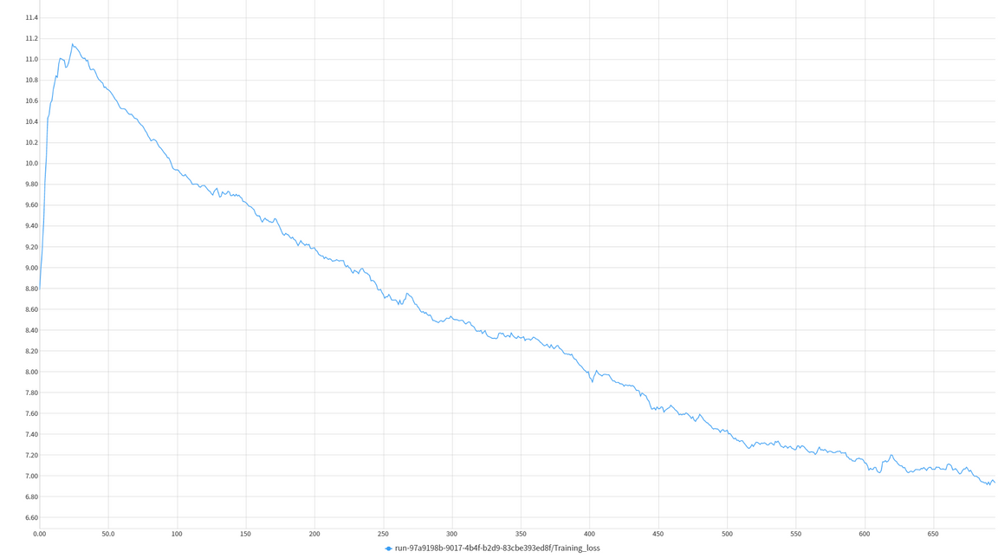

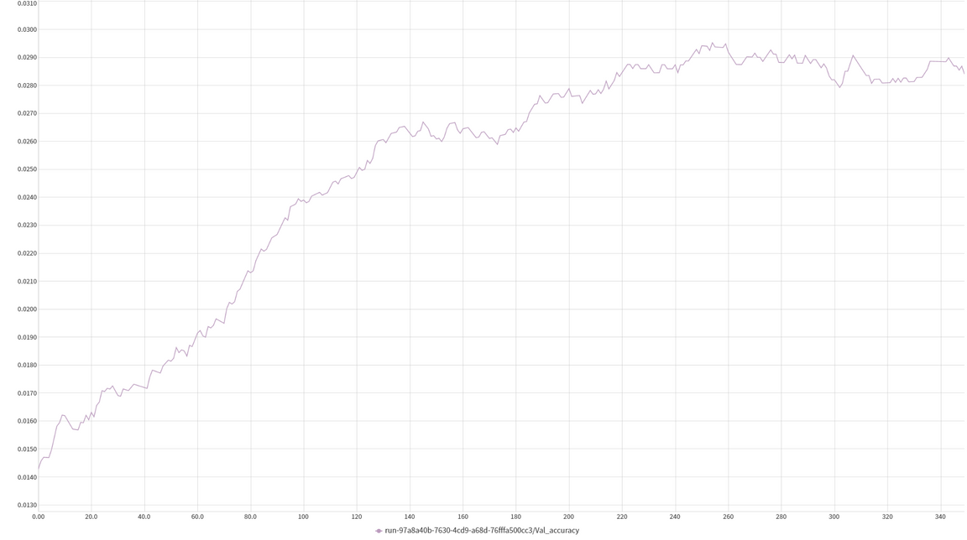


MODEL EVALUATION: ViT
Training accuracy
Training loss
validation accuracy

Slide 7
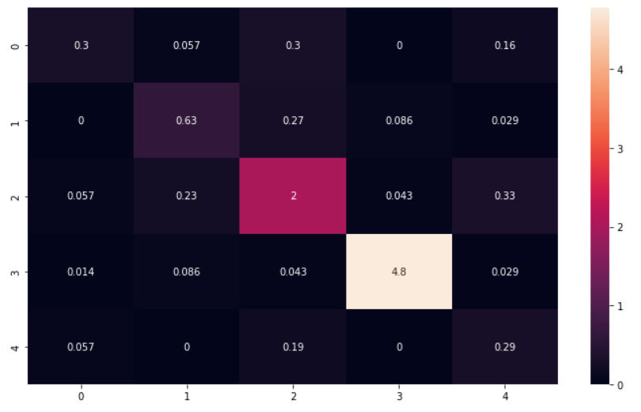
MODEL EVALUATION: RESNET
01
ACCURACY:
0.814072
02
PRECISION:
0.672866
03
RECALL :
0.649863
F1 SCORE :
0.646639
04

Slide 8
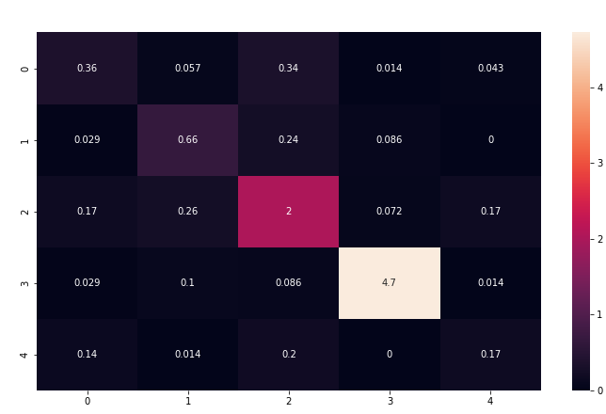
MODEL EVALUATION: DENSENET
01
ACCURACY:
0.78949
02
PRECISION:
0.63739
RECALL :
0.62291
03
F1 SCORE :
0.62808
04

Slide 9
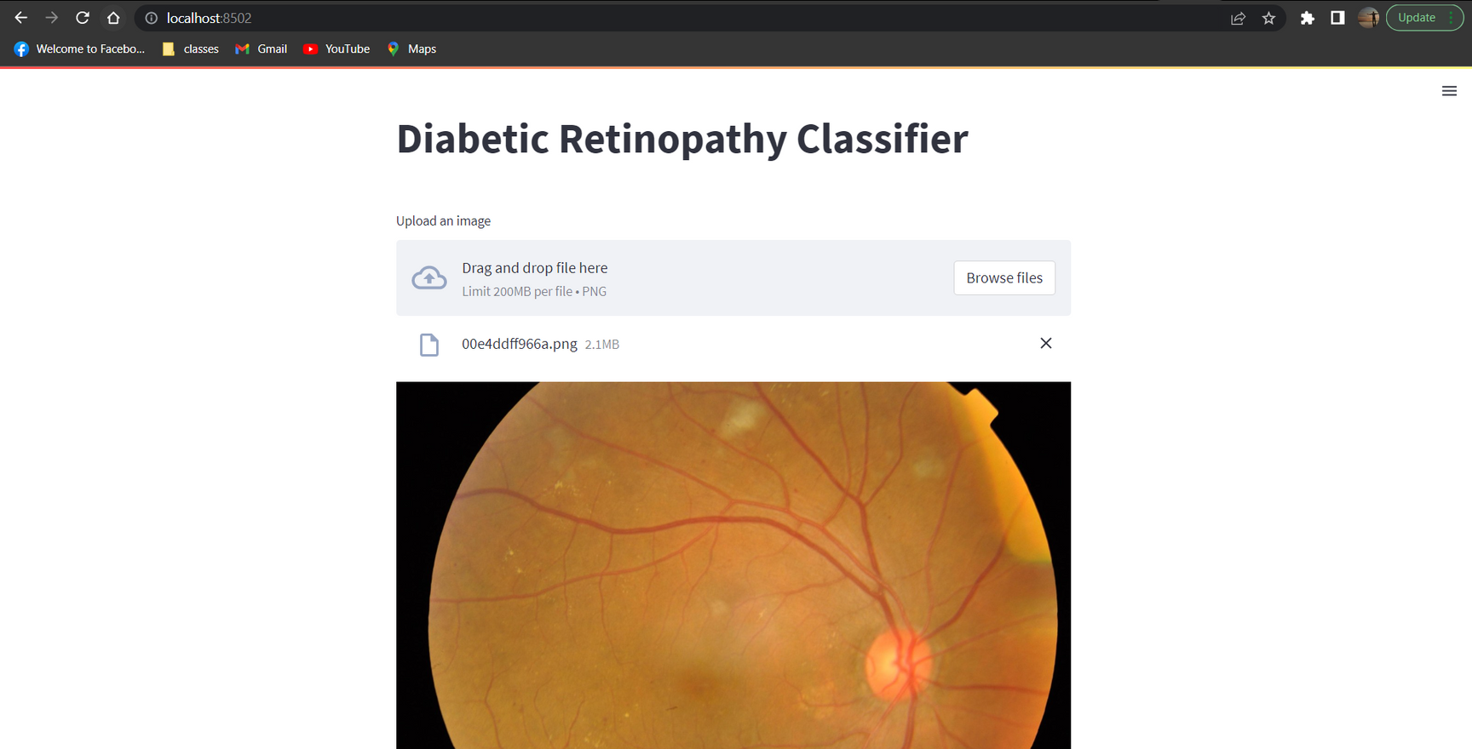

MODEL DEPLOYMENT
APPLICATION USING STREAM-LIT

Slide 10
COMPARISON
01
MODEL PERFORMANCE
81 % and 79 % for Resnet and Densenet respectively
02
TIME TAKEN
ViT took most time while Resnet scored least
03
MODEL COMPLEXITY
ViT is the most complex model with different layers

Slide 11
LIMITATIONS
Highly imbalanced dataset
Noisy images
Limited availability of HPC clusters
Limited free cloud resources

Slide 12
FUTURE WORK
Better training with HPC clusters
Model deployment with CI/CD methodologies
Advancement in de- centralised training
Development of light-weight models

Slide 13
References
https://naga-karthik.github.io/post/pytorch-ddp/

